Slide 1
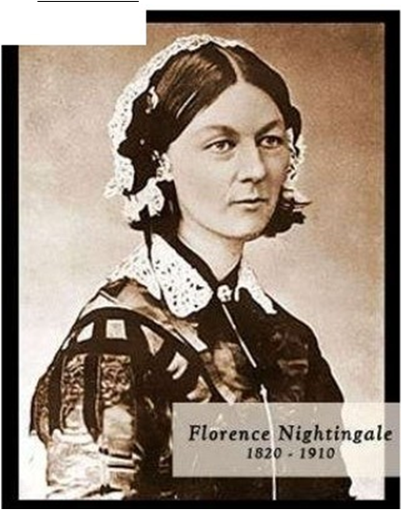
HISTORY OF FLORENCE NIGHTINGALE

Slide 2
EARLY LIFE
• Florence was named after the city in which she was born – Florence, Italy. Born in May 12, 1820, the second daughter in a well-to-do family.
She was well cultured, travelled and educated. She was multilingual as she had mastered 7 languages by the age of 17 and was equally proficient in the mathematical field.

Slide 3
Despite the luxurious upbringing, Nightingale lead a pious life with solid Christian values, that made her disdainful of such a wealthy lifestyle.
She believed that her true calling was to venture into nursing, an aspiration which was met by resistance from her family and the society.

Slide 4
CAREER IN NURSING
In here frequent travels, she began collecting information on public health and hospitals and soon became recognized as an important authority on the subject. This was during the onset of public health movement on hospital reforms in England.
She learnt about Pastor Fliedner's institute at Kaiserwerth where care was provided and nurses were trained. She visited Kaiserwerth briefly in 1850.

Slide 5
In 1851, at age 31, she spent 3 months studying at Kaiserwerth.
In 1853, she began working with a committee that supervised an ''Establishment for Gentlewomen During Illness." She eventually was appointed superintendent of the establishment, a position she held from August 1853 to October 1854.

Slide 6
CRIMEAN WAR
After the Crimean War began in March 1854, communications through the newly developed telegraph stated the terrible conditions in which the British Army cared for sick and wounded soldiers.
Florence Nightingale, by then a recognized authority on hospital care, wrote to her friend Sir Sidney Herbert, who was then Secretary of War, and offered to take a group of 38 nurses to the Crimea.

Slide 7
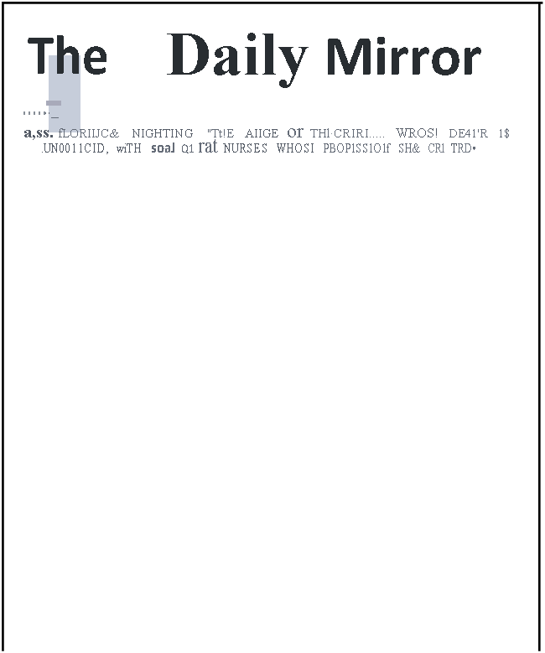
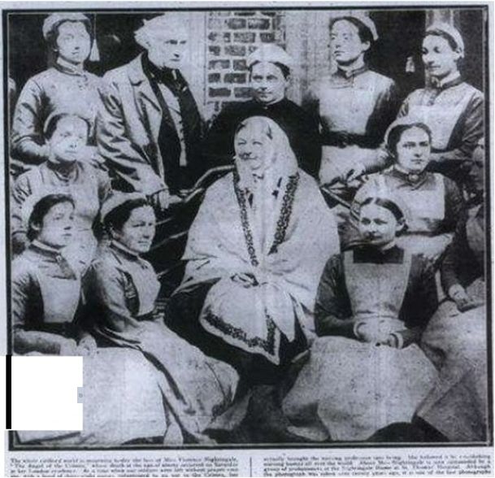
Her tireless efforts in the Crimea resulted in greatly reduced mortality rates among the sick and wounded.
When the war ended in 1856, Florence Nightingale returned
to England as a national
hero.

Slide 8
Her next major project involved working to change the entire approach to health for the British soldier. These activities included constructing hospitals and improving basic hygiene and public health measures for the army
She focused on providing cleanliness, wholesome food, fresh air, and separation of people from garbage and sewage both for living environments and for hospital construction. These simple public health measures were revolutionary in the late 1800s.
Throughout her lifetime, Florence Nightingale wrote extensively about hospitals, sanitation, health, and health statistics (creating the first pie chart), and especially about nursing and nursing education.

Slide 9
NIGHTINGALE’S ACHIEVEMENTS
She was appointed superintendent of the ''Establishment for Gentlewomen During Illness“ during illness from August 1853 to October 1854.
Published a book “Notes on Nursing”- 1859.
In 1907, she was recognized by the Queen of England, who awarded her the British Order of Merit. It was the first time it was given to a woman.

Slide 10
4. Led a team of 38 nurses to staff an overseas hospital of the British army during the Crimean war.
5. In 1860, she devoted her efforts to the creation of a school of nursing at St. Thomas’ Hospital in London, established to honour her work in Crimea. The school was established based on the following principles:
Nurses would be trained in teaching hospitals associated with medical schools and organized for that purpose.
Nurses would be selected carefully and would be located in nurses' houses designed to encourage discipline and form character.
The school matron would have final authority over the curriculum, living arrangements, and all other aspects of the school.
The curriculum would include both theoretic material and practical experience.
Teachers would be paid for their instruction.

Slide 11
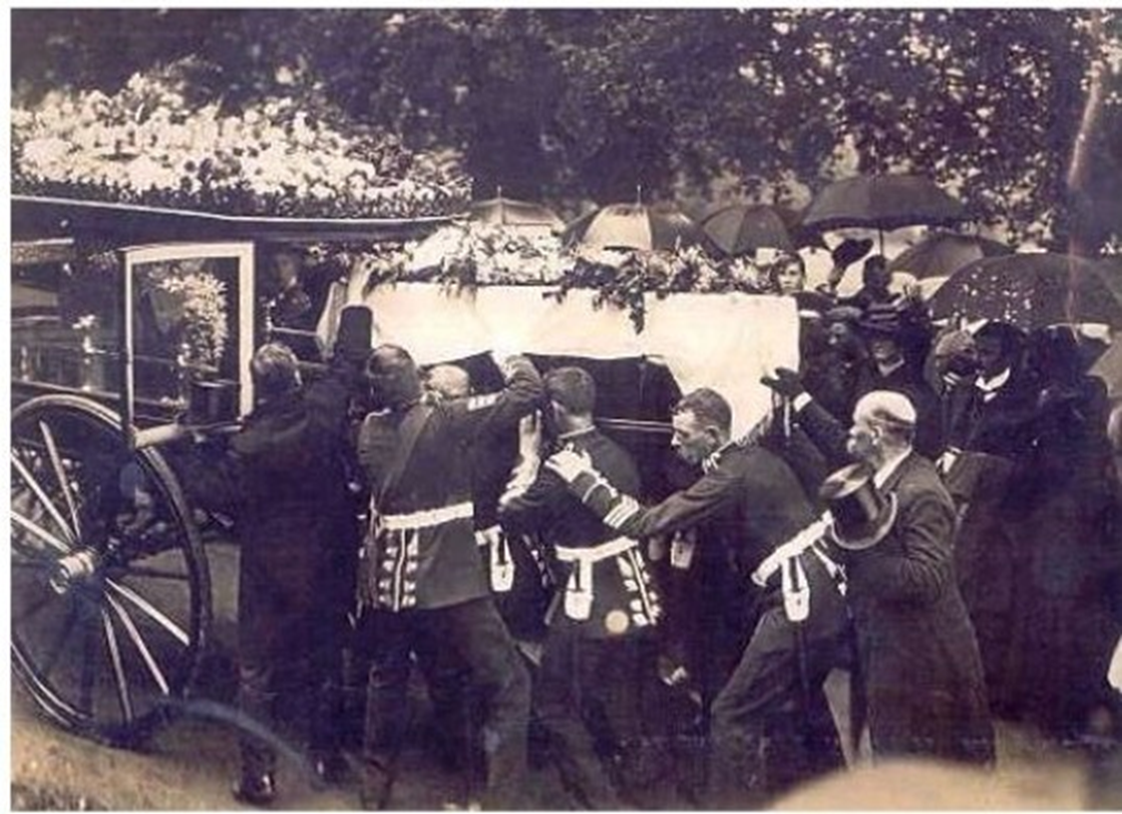
Florence Nightingale died in her sleep at the age of 90 on August 13, 1910.

Slide 12
CONCLUSION
Pioneer in statistics represented her analysis in graphical forms to ease drawing conclusions and actionables from data. Famous for usage of the polar area diagram (Nightingale rose diagram) equivalent to a modern circular histogram.
In recognition of her pioneering work in nursing , the Nightingale pledge is taken by new nurses and the Florence Nightingale medal, the highest international distinction a nurse can achieve were named in her honour and the International Nurses’ Day is celebrated on her birthday.

